Slide 1



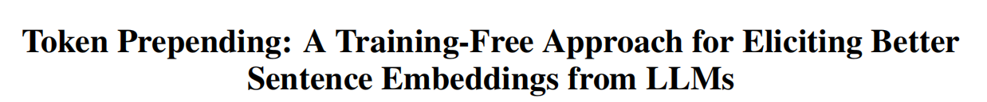
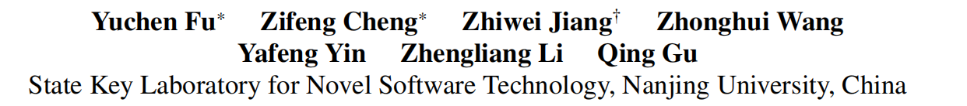





Chongqing University of Technology
ATAI
Advanced Technique of Artificial Intelligence
Chongqing University of Technology
https://github.com/fuyuchenIfyw/token_prepending.git.
—— ACL 2025
Reported by ZhiWei Xu

Slide 2
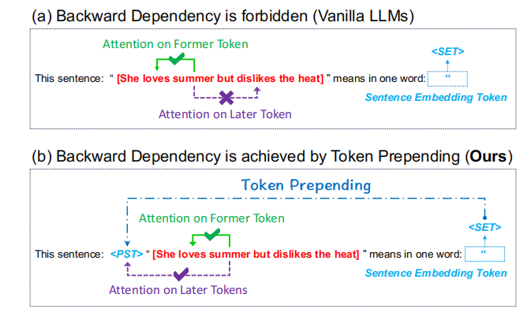
Motivation
1)However, LLMs are mostly decoder-only models with causal attention and the earlier tokens in the sentence cannot attend to the latter tokens, resulting in biased encoding of sentence information and cascading effects on the final decoded token.
2)To address this problem,some previous work has attempted to achieve backward dependency through
repetition.

Slide 3
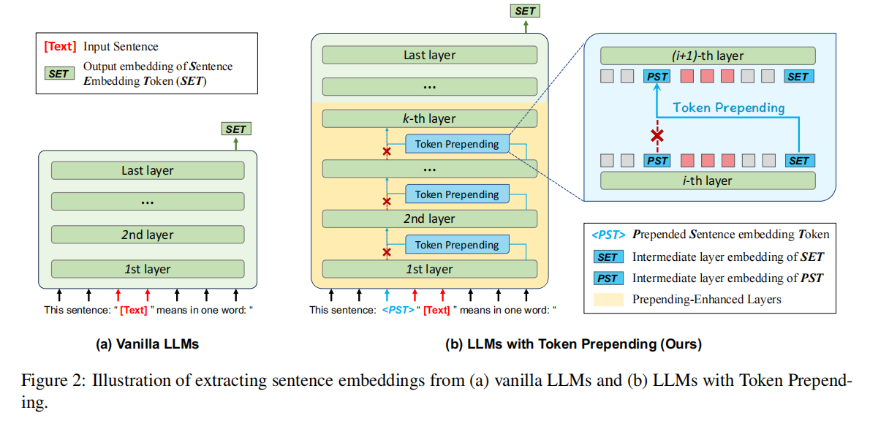
Method

Slide 4
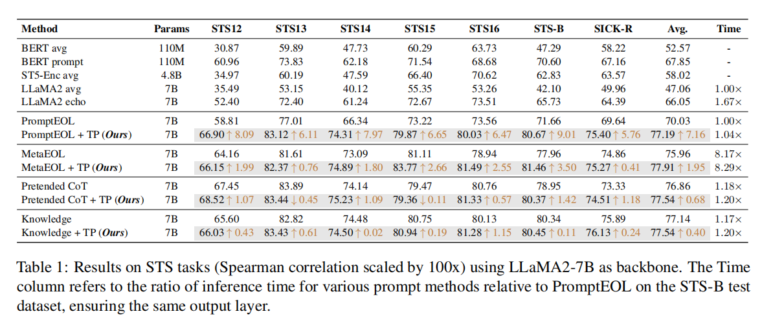
Experiments

Slide 5
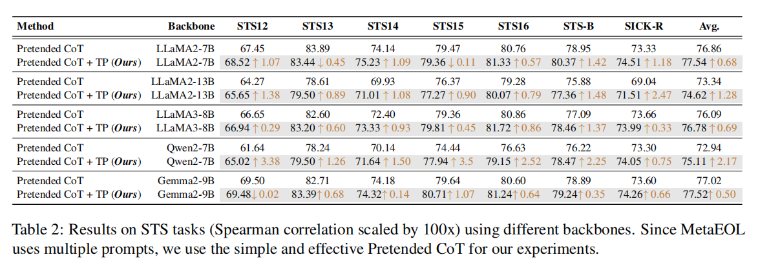
Experiments

Slide 6
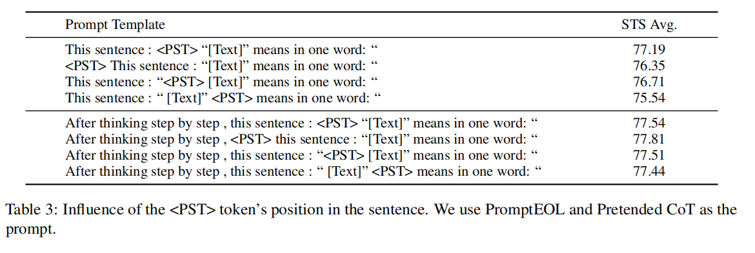
Experiments

Slide 7
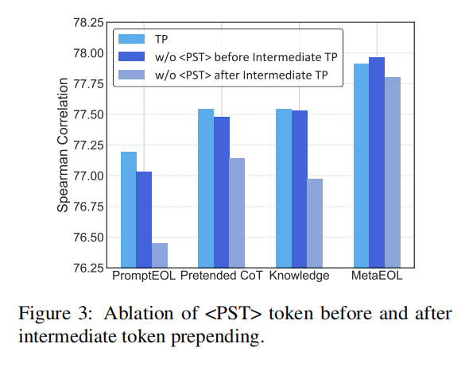
Experiments

Slide 8
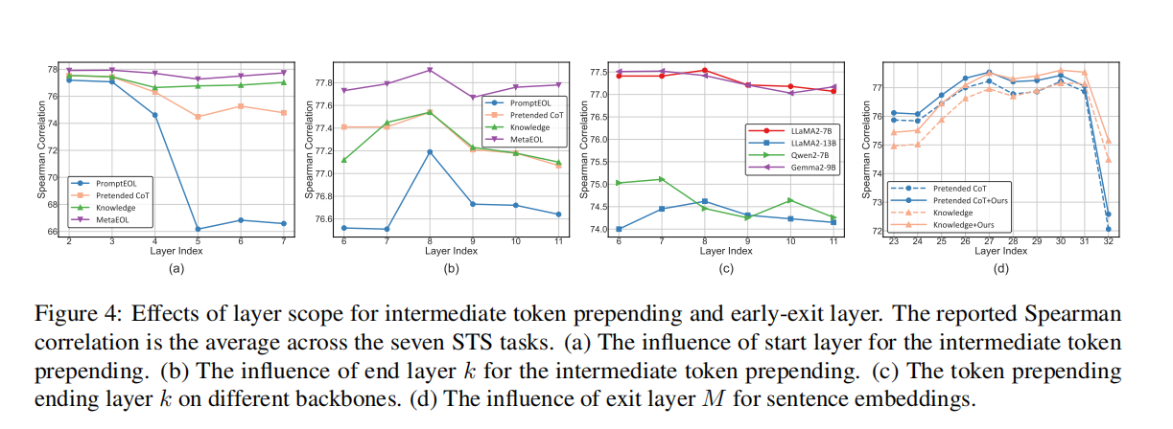
Experiments

Slide 9
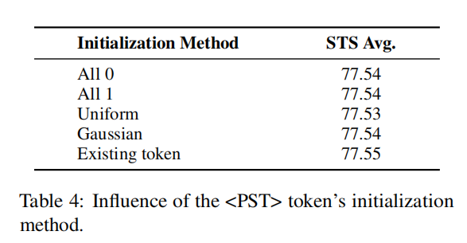
Experiments

Slide 10
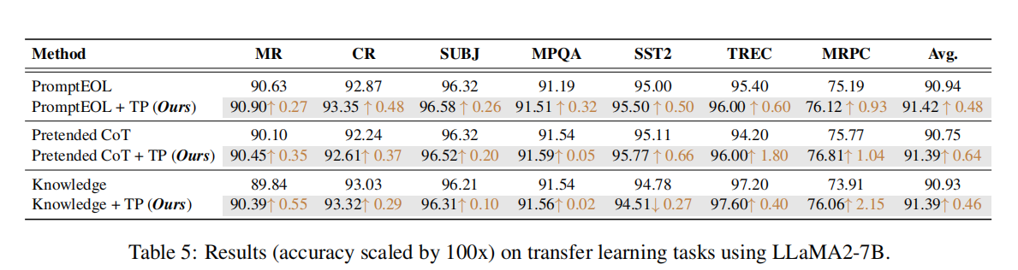
Experiments

Slide 11
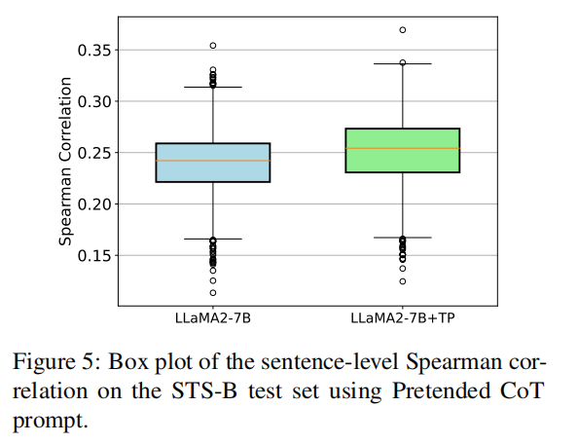
Experiments

Slide 12
Thanks!

